Slide 1
CS 295B/CS 395B Systems for Knowledge Discovery
Lecture 4:
Example presentations

Slide 2
Guidelines
Presentations should be 18-20minutes
Rough rating system
Bad – Factually incorrect or no discernable content
Fair – Regurgitates facts from the paper in the same order
Good – Provides narrative cohesion and insights beyond surface text of paper
Excellent – Advertises and entertains while teaching the audience something
Tip: do extra reading for context, read related or cited work, etc.

Slide 3
You cannot cover everything; make editorial choices

Slide 4
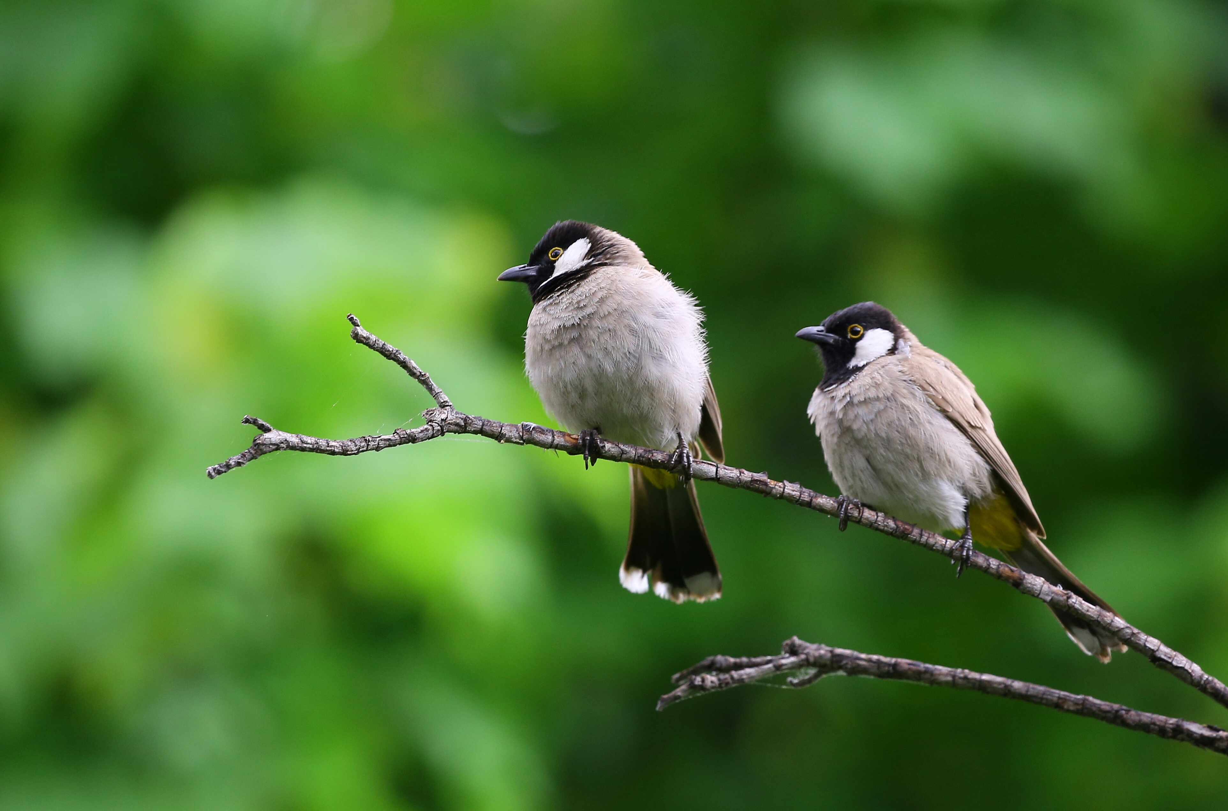
Try to mix things up, visually.

Slide 5
Outline
Overview
Example presentation 1(excellent)
Example presentation 2 (fair to good)
Analysis of presentations

Slide 6
Systems for KDD: From Concepts to Practice
Authors: Dunkel et al.
Presenter: Emma Tosch

Slide 7




Sales
Logs
Inventory
Notes:
Meet Stacy. Stacy does analytics for an e-commerce company <CLICK>.
Now, this company has several databases, for example, <CLICK> one to track sales <CLICK>, one that holds logged data from end-user interactions on the website, and <CLICK> one that tracks orders from the company vendors.
Now, it’s Stacy’s job to take this information and synthesize it <CLICK> into insights <CLICK>. Now, there is a lot of data in these databses that does not interest Stacy.

Slide 8
SELECT S.date, S.item, S.tid, S.iid
L.clicks, L.time, L.region,
I.stock
INTO Stacy
FROM Sales as S, Logs as L, Inventory as I
WHERE S.tid = L.tid
AND S.iid = I.iid
Sales
Logs
Inventory
Stacy
Notes:
So, in her first pass Stacy might do something like <CLICK> selecting out only the column data the that she thinks might be useful.
(Note that I’ve abused some notation here where we are treating databases as single tables)
Now, while Stacy is still in the data exploration phase, she might do some basic queries, still in SQL. For example,

Slide 9
SELECT AVG(time), AVG(clicks)
FROM Stacy
GROUP BY tid
Sales
Logs
Inventory
Stacy
Notes:
She might look at some summary statistics about behavior before purchase

Slide 10
SELECT *
FROM Stacy
WHERE region is NULL
Sales
Logs
Inventory
Stacy
Notes:
Or she might look at missing data.

Slide 11
Sales
Logs
Inventory
Stacy
Notes:
With time she adds some more information to her working database.
Now Stacy has a bunch of information in her database and she can start mining it for patterns. How does she do this?

Slide 12

from sklearn import datasets
from sklearn.tree import DecisionTreeClassifier
from sklearn import tree
import psycopg2 as p
from psycopg2 import Error
query = 'SELECT * from STACY'
conn = p.connect(
user = os.environ['DB_USER’],
password = os.environ['DB_PASS’],
host = 'localhost’,
port = '5432’,
database = 'Stacy'
)
cursor = conn.cursor()
cursor.execute(query)
result = cursor.fetchall()
# more manipulation until we get features X and outcome y
clf = DecisionTreeClassifier(random_state=1234)
model = clf.fit(X, y)
Stacy
Notes:
Well after cleaning up and playing around with some sample data via SQL, she decides she wants to know what features or behaviors lead to the sale of a specific class of items. She looks around and identifies a library for producing decision trees. It’s code that someone else wrote, so she treats it as a <CLICK> black box. Once she has this library, she uses it on her data; she first must define her query, which is straightforward here due to her earlier exploratory data analysis

Slide 13
from sklearn import datasets
from sklearn.tree import DecisionTreeClassifier
from sklearn import tree
import os
import psycopg2 as p
from psycopg2 import Error
query = 'SELECT * from STACY'
conn = p.connect(
user = os.environ['DB_USER’],
password = os.environ['DB_PASS’],
host = 'localhost’,
port = '5432’,
database = 'Stacy'
)
cursor = conn.cursor()
cursor.execute(query)
result = cursor.fetchall()
# more manipulation until we get features X and outcome y
clf = DecisionTreeClassifier(random_state=1234)
model = clf.fit(X, y)
Stacy
Notes:
Then Stacy sets up the connection to the database

Slide 14
from sklearn import datasets
from sklearn.tree import DecisionTreeClassifier
from sklearn import tree
import os
import psycopg2 as p
from psycopg2 import Error
query = 'SELECT * from STACY'
conn = p.connect(
user = os.environ['DB_USER’],
password = os.environ['DB_PASS’],
host = 'localhost’,
port = '5432’,
database = 'Stacy'
)
cursor = conn.cursor()
cursor.execute(query)
result = cursor.fetchall()
# more manipulation until we get features X and outcome y
clf = DecisionTreeClassifier(random_state=1234)
model = clf.fit(X, y)
Stacy
Notes:
And then she sets up the data to be loaded into memory

Slide 15
from sklearn import datasets
from sklearn.tree import DecisionTreeClassifier
from sklearn import tree
import os
import psycopg2 as p
from psycopg2 import Error
query = 'SELECT * from STACY'
conn = p.connect(
user = os.environ['DB_USER’],
password = os.environ['DB_PASS’],
host = 'localhost’,
port = '5432’,
database = 'Stacy'
)
cursor = conn.cursor()
cursor.execute(query)
result = cursor.fetchall()
# more manipulation until we get features X and outcome y
clf = DecisionTreeClassifier(random_state=1234)
model = clf.fit(X, y)
Stacy
Notes:
Then she does some manipulation to get the data in the proper structure for features X and outcome y

Slide 16
from sklearn import datasets
from sklearn.tree import DecisionTreeClassifier
from sklearn import tree
import os
import psycopg2 as p
from psycopg2 import Error
query = 'SELECT * from STACY'
conn = p.connect(
user = os.environ['DB_USER’],
password = os.environ['DB_PASS’],
host = 'localhost’,
port = '5432’,
database = 'Stacy'
)
cursor = conn.cursor()
cursor.execute(query)
result = cursor.fetchall()
# more manipulation until we get features X and outcome y
clf = DecisionTreeClassifier(random_state=1234)
model = clf.fit(X, y)
Stacy
Notes:
Until finally she can fit the data.

Slide 17
from sklearn import datasets
from sklearn.tree import DecisionTreeClassifier
from sklearn import tree
import os
import psycopg2 as p
from psycopg2 import Error
query = 'SELECT * from STACY'
conn = p.connect(
user = os.environ['DB_USER’],
password = os.environ['DB_PASS’],
host = 'localhost’,
port = '5432’,
database = 'Stacy'
)
cursor = conn.cursor()
cursor.execute(query)
result = cursor.fetchall()
# more manipulation until we get features X and outcome y
clf = DecisionTreeClassifier(random_state=1234)
model = clf.fit(X, y)
Stacy
Notes:
Until finally she can fit the data. So what does the learned representation look like?

Slide 18
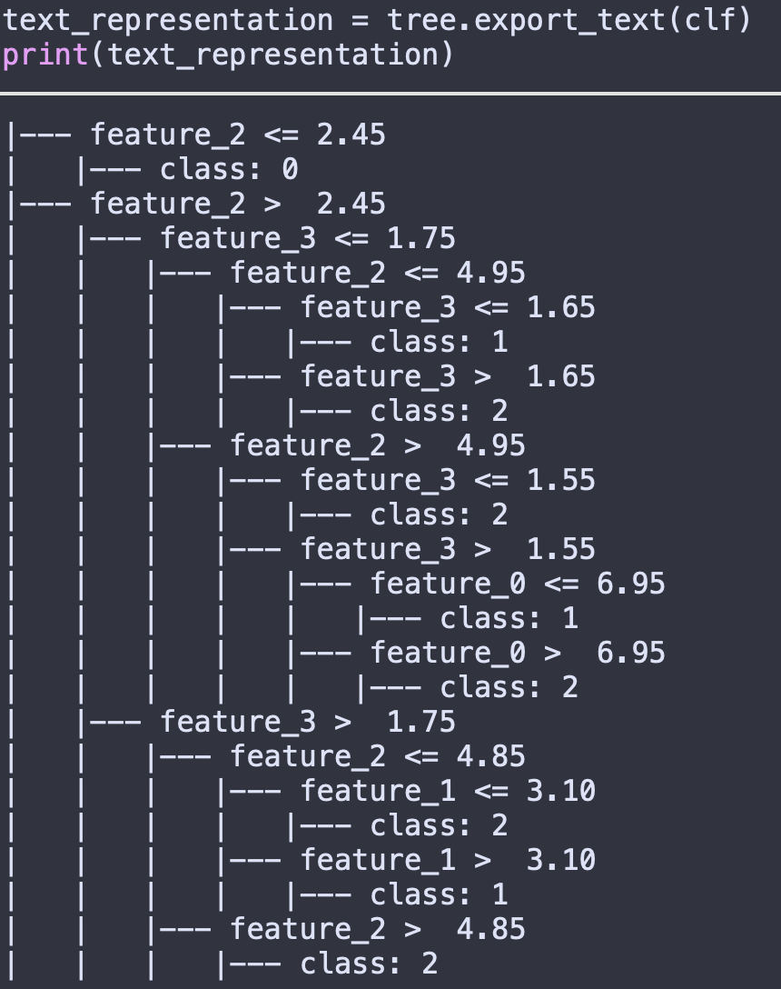
A quick look at the output
Interpret as a bunch of if-statements
Remember: the output is a class (e.g., binary classifier for sale of item class)
Can be hard to read
https://mljar.com/blog/visualize-decision-tree/

Slide 19
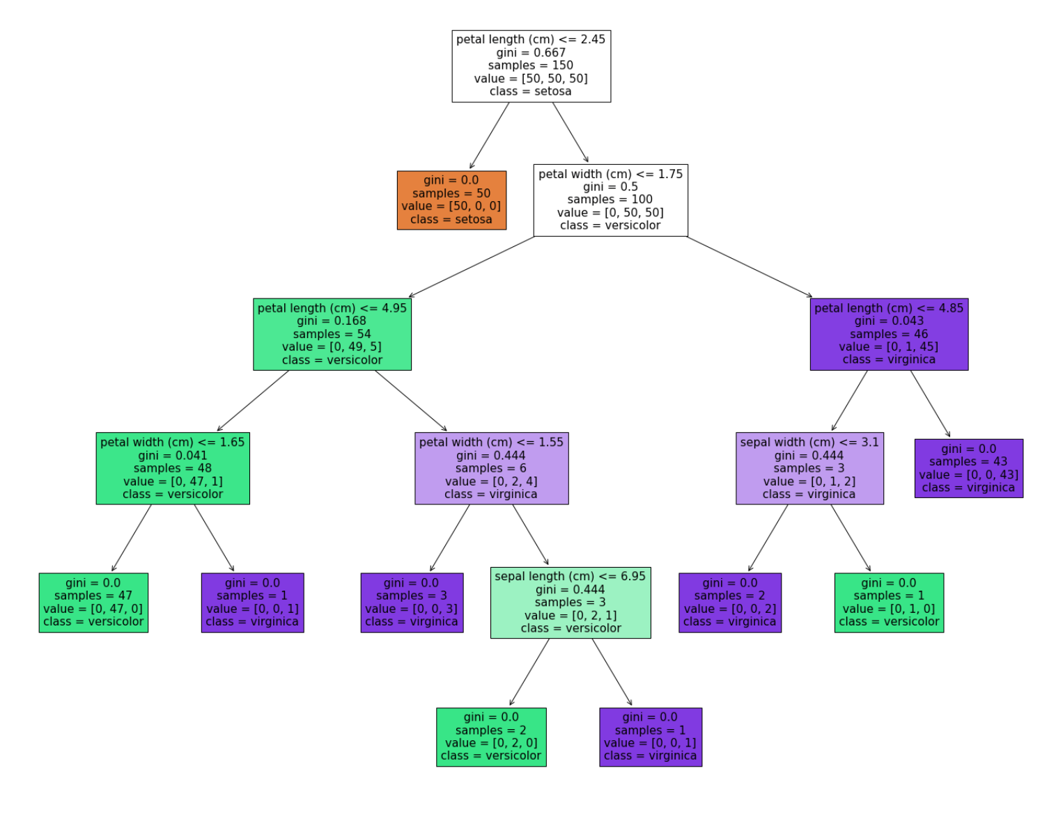
Visualize!
Load up new library (here, matplotlib)
Use colors to indicate majority class at this node
Can be shown to non-domain-experts
https://mljar.com/blog/visualize-decision-tree/

Slide 20
What could go wrong?

Slide 21
Sales
Logs
Inventory
Notes:
Suppose Stacy leaves the company.

Slide 22

Stacy
Sales
Logs
Inventory
Notes:
And the company hires a new person, Pacey. Now Pacey is asked to pick up where Stacy left off. So Pacey takes a look at the resources available, and notices <CLICK> the Stacy database. Pacey sees the column names from Stacy’s database tables, but doesn’t know how that data got into the database because Stacy didn’t leave behind files with those SQL queries from her earlier exploratory analyses. However, even if she had, she would have needed to be very clear about her documentation. Why?

Slide 23

from sklearn import datasets
from sklearn.tree import DecisionTreeClassifier
from sklearn import tree
import os
import psycopg2 as p
from psycopg2 import Error
query = 'SELECT * from STACY'
conn = p.connect(
user = os.environ['DB_USER’],
password = os.environ['DB_PASS’],
host = 'localhost’,
port = '5432’,
database = 'Stacy'
)
cursor = conn.cursor()
cursor.execute(query)
result = cursor.fetchall()
# more manipulation until we get features X and outcome y
clf = DecisionTreeClassifier(random_state=1234)
model = clf.fit(X, y)
Sales
Logs
Inventory
Stacy
Notes:
And the company hires a new person, Pacey. Now Pacey is asked to pick up where Stacy left off. So Pacey takes a look at the resources available, and notices <CLICK> the Stacy database and some analysis code <CLICK> Pacey sees the column names from Stacy’s database tables, but doesn’t know how that data got into the database because Stacy didn’t leave behind files with those SQL queries from her earlier exploratory analyses. However, even if she had, she would have needed to be very clear about her documentation. Why? <CLICK> because this collection of files still needs to be ordered, may not be idempotent, etc. The decision tree code is fine, but it’s also specific to a single hypothesis, which may not be useful to Pacey.

Slide 24


from sklearn import datasets
from sklearn.tree import DecisionTreeClassifier
from sklearn import tree
import os
import psycopg2 as p
from psycopg2 import Error
query = 'SELECT * from STACY'
conn = p.connect(
user = os.environ['DB_USER’],
password = os.environ['DB_PASS’],
host = 'localhost’,
port = '5432’,
database = 'Stacy'
)
cursor = conn.cursor()
cursor.execute(query)
result = cursor.fetchall()
# more manipulation until we get features X and outcome y
clf = DecisionTreeClassifier(random_state=1234)
model = clf.fit(X, y)
Tightly couple the steps of the KDD process…
Here, use a KDD-specific tool!
Sales
Logs
Inventory
Stacy
Notes:
So, as a computer scientist, <CLICK> Pacey has an idea. It’s a concept they learned in software engineering: <CLICK> tight coupling. However, rather than programming a KDD system de novo, Pacey looks into existing KDD tools.

Slide 25


Empirical Study: Approach
Goal Idea: build a system using principles from existing systems
Identify desirable components, prototype idealized system
Notes:
Now this leads us to the core contributions of this work.
Commercial: sales information (proxy for popularity)
Research: technical descriptions
We won’t go over the actual prototype system, since the authors didn’t report any interesting findings. Instead we will focus on their qualitative study of existing systems and the important properties any KDD system should have

Slide 26
Overview: existing system support for KDD
System | Select | Clean | Transform | Mine | Interpret | Evaluate
Intelligent Miner |  | ✓ | ✓
MineSet |  | ✓ | ✓ |  | ✓ | ✓
MLC++ |  |  |  | ✓ | ✓
Clementine | ✓ | ✓ |  | ✓ | ✓
DBMiner (includes GeoMiner) |  |  |  | ✓
IDIS | ✓ | ✓
Mobal | ✓ | ✓
DataSurveyor
Emerald |  |  |  |  |  | ✓
Notes:
The authors call out nine distinct systems throughout the paper, mostly for positive examples. Therefore, black does not mean that this information is missing.

Slide 27
Overview: existing system support for KDD
System | Select | Clean | Transform | Mine | Interpret | Evaluate
Intelligent Miner |  | ✓ | ✓
MineSet |  | ✓ | ✓ |  | ✓ | ✓
MLC++ |  |  |  | ✓ | ✓
Clementine | ✓ | ✓ |  | ✓ | ✓
DBMiner (includes GeoMiner) |  |  |  | ✓
IDIS | ✓ | ✓
Mobal | ✓ | ✓
DataSurveyor
Emerald |  |  |  |  |  | ✓
Notes:
The authors call out nine distinct systems throughout the paper, mostly for positive examples. Therefore, black does not mean that this information is missing.

Slide 28
Overview: existing system support for KDD
System | Select | Clean | Transform | Mine | Interpret | Evaluate
Intelligent Miner |  | ✓ | ✓
MineSet |  | ✓ | ✓ |  | ✓ | ✓
MLC++ |  |  |  | ✓ | ✓
Clementine | ✓ | ✓ |  | ✓ | ✓
DBMiner (includes GeoMiner) |  |  |  | ✓
IDIS | ✓ | ✓
Mobal | ✓ | ✓
DataSurveyor
Emerald |  |  |  |  |  | ✓
Notes:
The authors call out nine distinct systems throughout the paper, mostly for positive examples. Therefore, black does not mean that this information is missing.

Slide 29
Overview: existing system support for KDD
System | Select | Clean | Transform | Mine | Interpret | Evaluate
Intelligent Miner |  | ✓ | ✓
MineSet |  | ✓ | ✓ |  | ✓ | ✓
MLC++ |  |  |  | ✓ | ✓
Clementine | ✓ | ✓ |  | ✓ | ✓
DBMiner (includes GeoMiner) |  |  |  | ✓
IDIS | ✓ | ✓
Mobal | ✓ | ✓
DataSurveyor
Emerald |  |  |  |  |  | ✓
Notes:
The authors call out nine distinct systems throughout the paper, mostly for positive examples. Therefore, black does not mean that this information is missing.

Slide 30
Overview: existing system support for KDD
System | Select | Clean | Transform | Mine | Interpret | Evaluate
Intelligent Miner |  | ✓ | ✓
MineSet |  | ✓ | ✓ |  | ✓ | ✓
MLC++ |  |  |  | ✓ | ✓
Clementine | ✓ | ✓ |  | ✓ | ✓
DBMiner (includes GeoMiner) |  |  |  | ✓
IDIS | ✓ | ✓
Mobal | ✓ | ✓
DataSurveyor
Emerald |  |  |  |  |  | ✓
Notes:
The authors call out nine distinct systems throughout the paper, mostly for positive examples. Therefore, black does not mean that this information is missing.

Slide 31
Overview: existing system support for KDD
System | Select | Clean | Transform | Mine | Interpret | Evaluate
Intelligent Miner |  | ✓ | ✓
MineSet |  | ✓ | ✓ |  | ✓ | ✓
MLC++ |  |  |  | ✓ | ✓
Clementine | ✓ | ✓ |  | ✓ | ✓
DBMiner (includes GeoMiner) |  |  |  | ✓
IDIS | ✓ | ✓
Mobal | ✓ | ✓
DataSurveyor
Emerald |  |  |  |  |  | ✓
Notes:
The authors call out nine distinct systems throughout the paper, mostly for positive examples. Therefore, black does not mean that this information is missing.

Slide 32
Existing system support for DM
System | Neural Nets | Rule Induction | Decision Trees | Other | Generalization | Characterization | Association
Intelligent Miner
MineSet |  | ✓ | ✓
MLC++ |  |  | ✓
Clementine | ✓ | ✓
DBMiner (includes GeoMiner) |  |  |  | ✓ | ✓ | ✓ | ✓
IDIS
Mobal
DataSurveyor
Emerald
Notes:
Authors didn’t go through these much

Slide 33
Existing system support for DM
System | Neural Nets | Rule Induction | Decision Trees | Other | Generalization | Characterization | Association
Intelligent Miner
MineSet |  | ✓ | ✓
MLC++ |  |  | ✓
Clementine | ✓ | ✓
DBMiner (includes GeoMiner) |  |  |  | ✓ | ✓ | ✓ | ✓
IDIS
Mobal
DataSurveyor
Emerald
Notes:
Authors didn’t go through these much

Slide 34
Existing systems: systems considerations
System | Het. HW/OS | Parallelization/Efficiency | Modularity | API/DX Interop | Code Generation | Easy Iteration
Intelligent Miner | ✗ |  |  | ✓
MineSet | ✗ |  | ✓ | ✓
MLC++ |  |  |  | ✓
Clementine | ✓ |  |  |  | ✓ | ✓
DBMiner (includes GeoMiner) | ✓ |  |  |  |  | ✓
IDIS | ✓ | ✓
Mobal |  |  |  | ✓ |  | ✓
DataSurveyor |  | ✓
Emerald |  |  | ✓ |  |  | ✓
Notes:
Today: GPUs

Slide 35
Existing systems: systems considerations
System | Het. HW/OS | Parallelization/Efficiency | Modularity | API/DX Interop | Code Generation | Easy Iteration
Intelligent Miner | ✗ |  |  | ✓
MineSet | ✗ |  | ✓ | ✓
MLC++ |  |  |  | ✓
Clementine | ✓ |  |  |  | ✓ | ✓
DBMiner (includes GeoMiner) | ✓ |  |  |  |  | ✓
IDIS | ✓ | ✓
Mobal |  |  |  | ✓ |  | ✓
DataSurveyor |  | ✓
Emerald |  |  | ✓ |  |  | ✓
Notes:
Today: GPUs

Slide 36
Existing systems: systems considerations
System | Het. HW/OS | Parallelization/Efficiency | Modularity | API/DX Interop | Code Generation | Easy Iteration
Intelligent Miner | ✗ |  |  | ✓
MineSet | ✗ |  | ✓ | ✓
MLC++ |  |  |  | ✓
Clementine | ✓ |  |  |  | ✓ | ✓
DBMiner (includes GeoMiner) | ✓ |  |  |  |  | ✓
IDIS | ✓ | ✓
Mobal |  |  |  | ✓ |  | ✓
DataSurveyor |  | ✓
Emerald |  |  | ✓ |  |  | ✓
Notes:
Concurrent SQL queries, sampling

Slide 37
Existing systems: systems considerations
System | Het. HW/OS | Parallelization/Efficiency | Modularity | API/DX Interop | Code Generation | Easy Iteration
Intelligent Miner | ✗ |  |  | ✓
MineSet | ✗ |  | ✓ | ✓
MLC++ |  |  |  | ✓
Clementine | ✓ |  |  |  | ✓ | ✓
DBMiner (includes GeoMiner) | ✓ |  |  |  |  | ✓
IDIS | ✓ | ✓
Mobal |  |  |  | ✓ |  | ✓
DataSurveyor |  | ✓
Emerald |  |  | ✓ |  |  | ✓
Notes:
DX == data exchange

Slide 38
Existing systems: systems considerations
System | Het. HW/OS | Parallelization/Efficiency | Modularity | API/DX Interop | Code Generation | Easy Iteration
Intelligent Miner | ✗ |  |  | ✓
MineSet | ✗ |  | ✓ | ✓
MLC++ |  |  |  | ✓
Clementine | ✓ |  |  |  | ✓ | ✓
DBMiner (includes GeoMiner) | ✓ |  |  |  |  | ✓
IDIS | ✓ | ✓
Mobal |  |  |  | ✓ |  | ✓
DataSurveyor |  | ✓
Emerald |  |  | ✓ |  |  | ✓
Notes:
Output C code for DM

Slide 39
Existing systems: systems considerations
System | Het. HW/OS | Parallelization/Efficiency | Modularity | API/DX Interop | Code Generation | Easy Iteration
Intelligent Miner | ✗ |  |  | ✓
MineSet | ✗ |  | ✓ | ✓
MLC++ |  |  |  | ✓
Clementine | ✓ |  |  |  | ✓ | ✓
DBMiner (includes GeoMiner) | ✓ |  |  |  |  | ✓
IDIS | ✓ | ✓
Mobal |  |  |  | ✓ |  | ✓
DataSurveyor |  | ✓
Emerald |  |  | ✓ |  |  | ✓
Notes:
Output C code for DM

Slide 40
Conclusions
Building KDD systems is hard, but worthwhile
Existing systems (as of the 90s) supported a wide array of functionality
Iterative human-centered parts are the hardest

Slide 41
A Database Perspective on Knowledge Discovery
Authors: Imielinksi and Mannila
Presenter: Emma Tosch

Slide 42

Context
Not a research article per se
Appeared in the Communications of the ACM (CACM) in November 1996
For a general CS audience

Slide 43
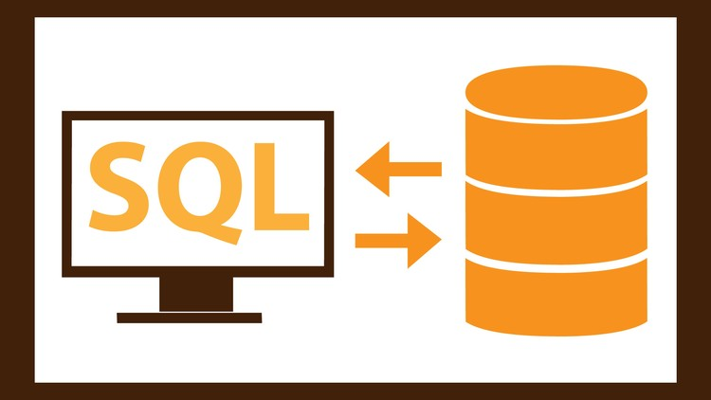
What is SQL?
”Structured Query Language”
Small number of primitives
SELECT columns from tables
Filter data WHERE constraints are true
JOIN tables on columns (i.e., find rows that match content)
Compute aggregates (AVG, COUNT, VAR)
Returns data (as tuples) from a database
This Photo by Unknown Author is licensed under CC BY-NC

Slide 44
What are ad hoc queries?
SELECT <col+> FROM <tab+> INNER JOIN <constraint*>
(not the complete grammar)
Combinatorial grammar == endless possibilities
(can’t optimize for specific tables or joins)

Slide 45

Big Questions
Performance: How do we make the KDD process faster?
Functionality: How do we do closure?

Slide 46

Performance
Article doesn’t go into much detail
Tighter coupling
The future will push for this
Analogy with I/O and traditional database systems
This Photo by Unknown Author is licensed under CC BY-NC

Slide 47
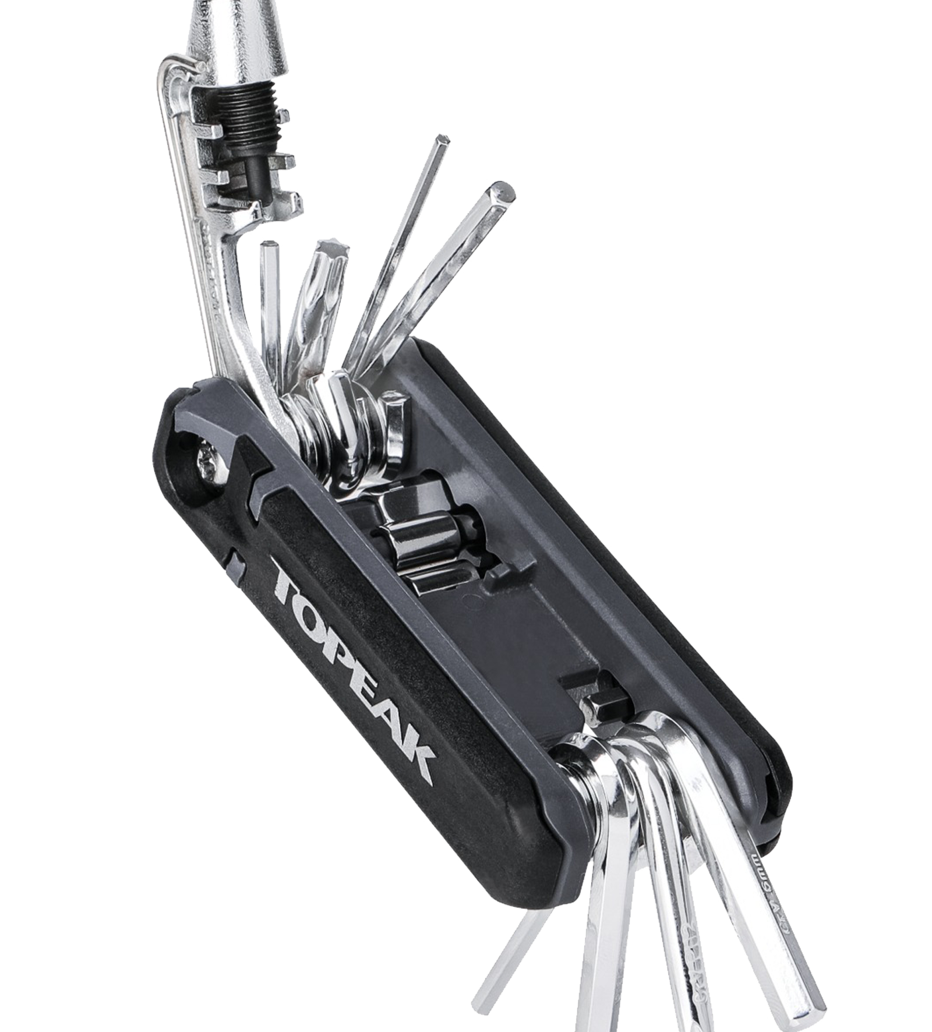
Functionality
Question: What do we want knowledge querying systems to be able to do?
Answer: all the things, very well
How? Closure.
This Photo by Unknown Author is licensed under CC BY-NC

Slide 48
What is the problem with existing KDD systems (in 1996)?
Not pluggable
Specific to a particular data mining technique
Basically no re-usable components
Data mining disconnected (conceptually) from data storage
What to do with “KDD objects?”

Slide 49
Closure
Want to compose queries and KDD objects
Queries can be regular SQL queries or special KDD SQL queries
Closure allows embedding in a host language or application

Slide 50
Why rule generation is Hard
Consider simple association rules (Horn clauses):
P1, P2, .., Pn → Q
Total number of possible rules is exponential in the number of columns in the simplest case.
(enumerating these is what we mean by “Any database implicitly defines the collection of all propositional or predicate rules in it.”)

Slide 51
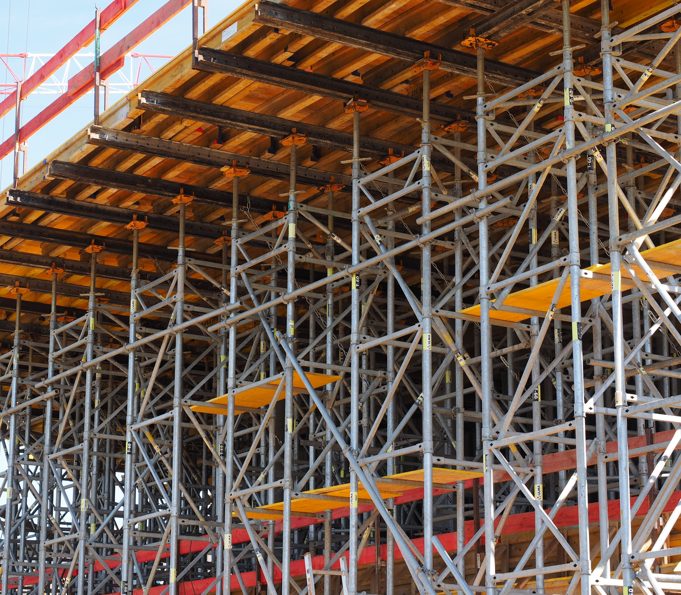
All rules share structure
Body: P1, ... Pn
Consequent: Q
Support: number of data points (used to compute power?)
Confidence: Frequency
Rules look like querying!

Slide 52
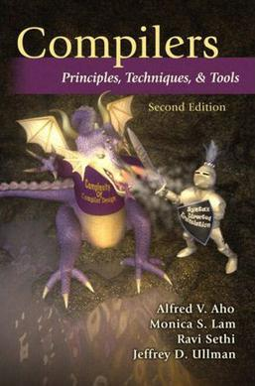
Good knowledge queries can be compiled
“regular” SQL is compiled and optimized
Need support for high-level primitives and composition
Clever optimizations come from the data itself
This Photo by Unknown Author is licensed under CC BY-SA

Slide 53

Conclusion
Querying tools must support KDD objects for interoperability and optimized performance!
This Photo by Unknown Author is licensed under CC BY-SA

Slide 54
Meta

Slide 55
Talk structure
Ground the work with an example, story, or context
Identify the problem and why it is important
State the solution
Walk the audience through the high-level components of the solution
Focus on easy-to-understand examples (remember: the talk is an advertisement)

Slide 56
Good: summarizing factual information

Slide 57
Closure
Want to compose queries and KDD objects
Queries can be regular SQL queries or special KDD SQL queries
Closure allows embedding in a host language or application

Slide 58
Excellent: synthesizing factual information into an easily-digestable format

Slide 59
Existing systems: systems considerations
System | Het. HW/OS | Parallelization/Efficiency | Modularity | API/DX Interop | Code Generation | Easy Iteration
Intelligent Miner | ✗ |  |  | ✓
MineSet | ✗ |  | ✓ | ✓
MLC++ |  |  |  | ✓
Clementine | ✓ |  |  |  | ✓ | ✓
DBMiner (includes GeoMiner) | ✓ |  |  |  |  | ✓
IDIS | ✓ | ✓
Mobal |  |  |  | ✓ |  | ✓
DataSurveyor |  | ✓
Emerald |  |  | ✓ |  |  | ✓
Notes:
DX == data exchange

Slide 60
An excellent presentation can always be improved

Slide 61
Overview: existing system support for KDD
Should have had visual examples for each of these
System | Select | Clean | Transform | Mine | Interpret | Evaluate
Intelligent Miner |  | ✓ | ✓
MineSet |  | ✓ | ✓ |  | ✓ | ✓
MLC++ |  |  |  | ✓ | ✓
Clementine | ✓ | ✓ |  | ✓ | ✓
DBMiner (includes GeoMiner) |  |  |  | ✓
IDIS | ✓ | ✓
Mobal | ✓ | ✓
DataSurveyor
Emerald |  |  |  |  |  | ✓

Slide 62

Good luck!
This Photo by Unknown Author is licensed under CC BY-NC

